Slide 2
"Five percent of the people think; ten percent of the people think they think; and the other eighty-five percent would rather die than think.” - Edison

Slide 3

A Reasoned Faith
Thinking Through Denominations

Slide 4
Jesus prayed that they all be one (Jn 17:20-21)
One assembly, one faith, one baptism (Eph. 1:22-23, 4:4f)
Do not think beyond what is written (1 Cor. 4:6)
God challenges us to think

Slide 5
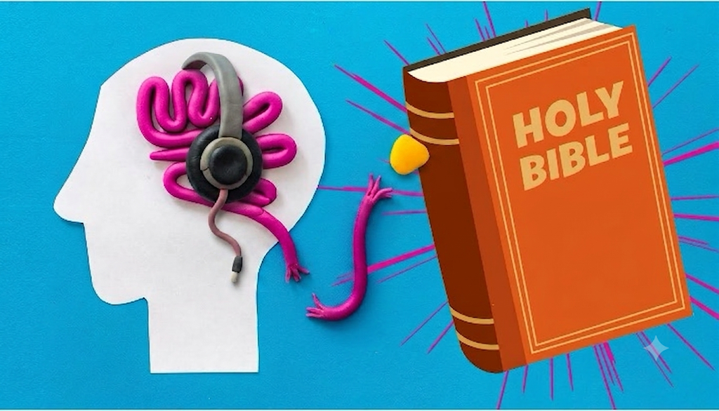
The Passive Public
“Primary & Secondary issues” (Eph. 4:4-6, Rom. 14)
One body, many members (1 Cor 12)
Jerusalem Conference (Acts 15)
“They’re not against us” (Mk. 9:39-40)

Slide 6
Reasoners and Reality
What it means to “denominate” and title versus describe (1 Cor. 1:12)
Denominations are evil because of their unauthorized functions (Matt 15)
Reject the Premise (1 Cor., Col. 4:16)

